Slide 1


Hospital Universitari Vall d’Hebron
Institut de Recerca - VHIR
Institut d’Investigació Sanitària de l’Instituto de Salud Carlos III (ISCIII)
Introduction to RNA-seq and
RNA-seq Data Analysis
Bioinformatics Course
Ferran Briansó and Alex Sánchez ferran.brianso@vhir.org

Slide 2
1
OVERVIEW
2
RNA-SEQ ANALYSIS PIPELINE(S)
3
NORMALIZATION METHODS
4
DIFFERENTIAL EXPRESSION TESTING
5
Complements

Slide 3
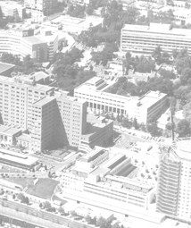
Disclaimer
This lecture is based on many presentations freely available in the web.
We wish to acknowledge the authors for their efforts and for making their work available
1

Slide 4
Transcriptomics by NGS

Slide 5
Evolution of transcriptomics technologies
1
Northern Blot
RT-PCR
Microarrays
(NGS) RNA-seq
Single Genes
Multiple genes
Whole Genomes
Populations of genomes

Slide 6
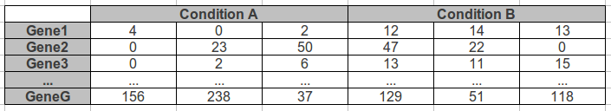
What is RNA-seq?
1
RNA-seq is the high throughput sequencing of cDNA using NGS technologies
RNA-seq works by sequencing every RNA molecule and profiling the expression of a particular gene by counting the number of time its transcripts have been sequenced.
The summarized RNA-Seq data is widely known as count data

Slide 7
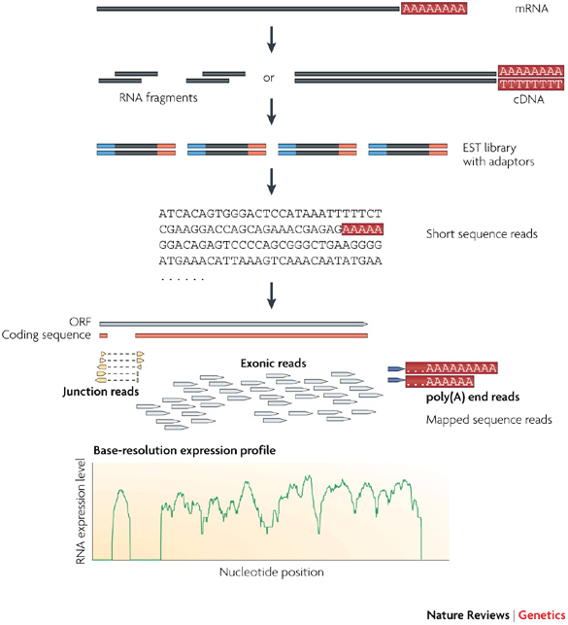
A typical RNA-seq experiment
Briefly, long RNAs are first converted into a library of cDNA fragments through either RNA fragmentation or DNA fragmentation (see main text). Sequencing adaptors (blue) are subsequently added to each cDNA fragment and a short sequence is obtained from each cDNA using high-throughput sequencing technology. The resulting sequence reads are aligned with the reference genome or transcriptome, and classified as three types: exonic reads, junction reads and poly(A) end-reads. These three types are used to generate a base-resolution expression profile for each gene, as illustrated at the bottom; a yeast ORF with one intron is shown.
Nature Reviews Genetics 10, 57-63 (January 2009)
Notes:
Briefly, long RNAs are first converted into a library of cDNA fragments through either RNA fragmentation or DNA fragmentation (see main text). Sequencing adaptors (blue) are subsequently added to each cDNA fragment and a short sequence is obtained from each cDNA using high-throughput sequencing technology. The resulting sequence reads are aligned with the reference genome or transcriptome, and classified as three types: exonic reads, junction reads and poly(A) end-reads. These three types are used to generate a base-resolution expression profile for each gene, as illustrated at the bottom; a yeast ORF with one intron is shown.

Slide 8
Why use RNA-seq
Unique new possibilities
Evaluate absolute transcript level of sequenced and unsequenced organisms.
Detect novel transcripts and isoforms
Map exon/intron boundaries, splice junctions
Analyze alternative splicing
Reveal sequence variations (e.g. SNPs) and splice variants

Slide 9
It has limitations too ...
Non-uniformity coverage of the genome due to experimental factors
Transcript-length bias
Read mapping uncertainty caused by sequencing error rates, repetitive elements, incomplete genome sequence, etc
Downstream bioinformatics algorithm/software need to be improved
Cost more than microarray

Slide 10
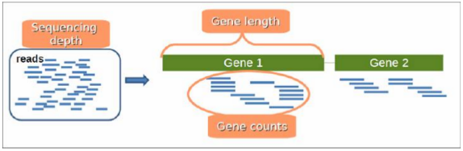
Important concepts
1
Sequencing depth (Library size): Total number of reads mapped to the genome.
Gene length: Number of bases that a gene has.
Gene counts: Number of reads mapping to that gene (expression measurement).

Slide 11
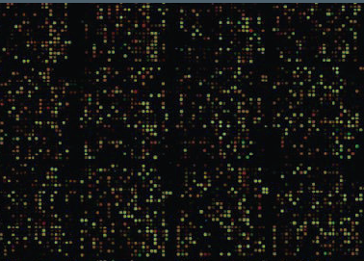
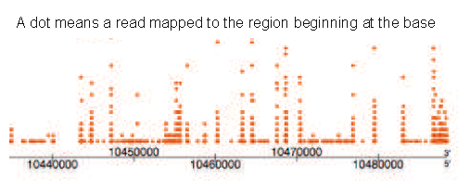
Microarrays vs NGS
RNA-seq can be seen as the NGS-counterpart of microarrays
Analog Signal
Easy to convey the signal’s information
Continuous strength
Signal loss and distortion
Digital Signal
Harder to achieve & interpret
Reads counts: discrete values
Weak background or no noise

Slide 12
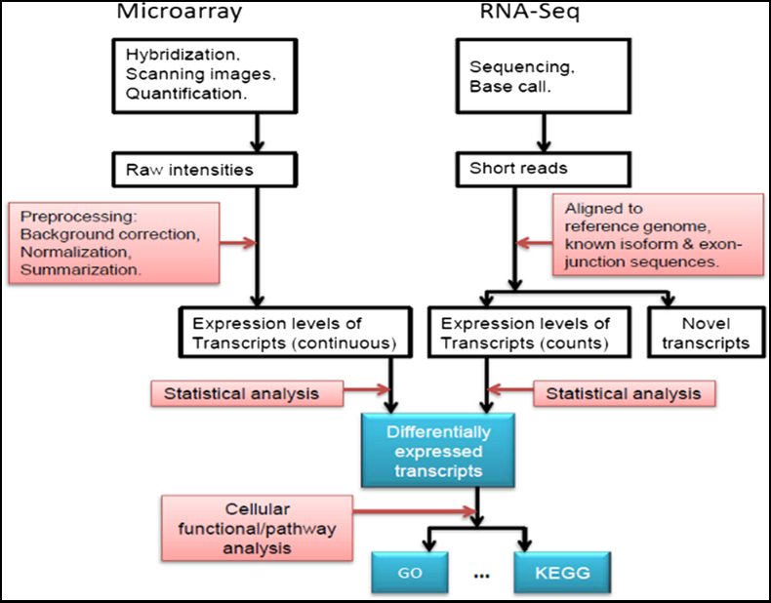
Microarrays and NGS pipelines
1

Slide 13
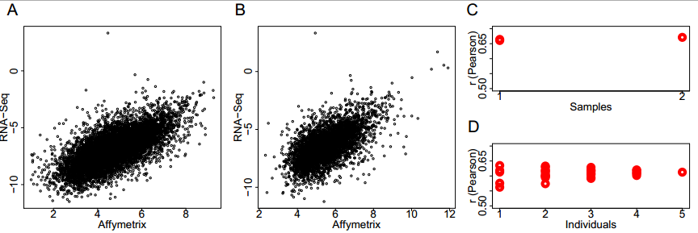
RNA seq and microarrays yield correlated results
Notes:
Correlation between mRNA expression levels measured by Affymetrix microarrays and RNA-Seq. mRNA expression levels measured by RNA-Seq in two pooled samples of 5 individuals and by microarrays in the same samples (A) or in 5 independent individual samples (B). Shown are expression levels of 8,441 and 4,758 genes, respectively, expressed above background on at least one of the microarrays in a given experiment and represented by at least two independent sequence reads in RNA-Seq (see Methods for details). (C and D) Person correlation coefficients (r) from comparisons between RNA-Seq and microarray measurements based on each microarray separately and on average expression from all possible microarray combinations for two pooled and 5 individual samples, respectively (see Additional file 1: Table S3 for details).
Fu et al. BMC Genomics 2009 10:161 doi:10.1186/1471-2164-10-161

Slide 14
Pros and cons of RNA-seq and microarrays
Microarrays
RNA-seq
☺
Costs,
well established methods, small data
☹
Hybridization bias,
sequence must be known
☺
High reproducibility,
not limited to expression
☹
Cost
Complexity of analysis

Slide 15
So what?
It is generally agreed/believed/expected that RNA-seq will soon replace microarrays for many uses. But not for all uses
There are still situations where the “simplicity” of microarrays yields the necessary information at an optimal cost.
Microarrays are now part of the standard molecular biology toolbox whereas RNA-seq is still in development.

Slide 16
RNA-seq analysis
(workflows, pipelines, protocols…)

Slide 17
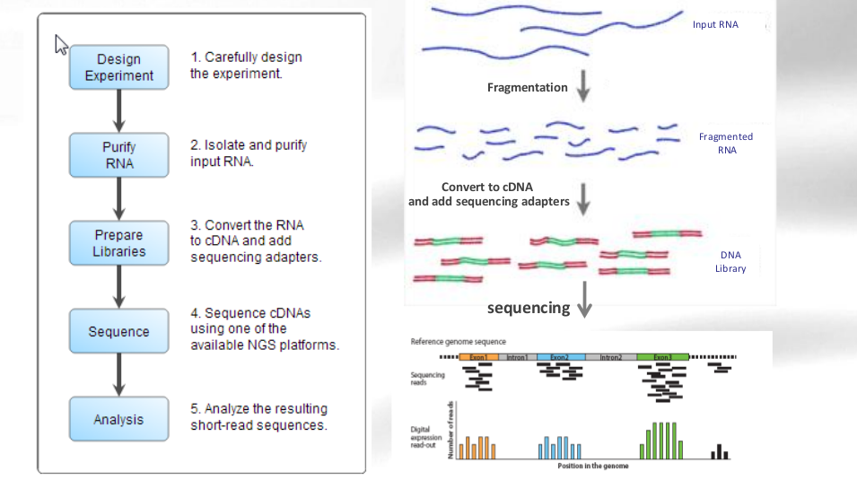
RNA-seq analysis workflow
1

Slide 18
RNA-seq analysis workflow
1

Slide 19
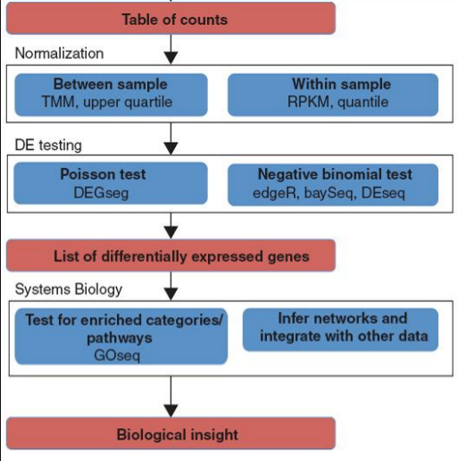
RNA-seq analysis workflow
Reads are mapped to the reference genome or transcriptome
Mapped reads are assembled into expression summaries (tables of counts, showing how may reads are in coding region, exon, gene or junction)
Data is normalized
Statistical testing of differential expression (DE) is performed, producing a list of genes with p-values and fold changes.
Similar downstream analysis than microarray results (Functional Annotations, Gene Enrichment Analysis; Integration with other data...)
Tools for base calling, sequence quality control,
alignment, mapping, summarizing...
FastQC, FastX, Bowtie/Picard, TopHat,
Cufflinks, Cuffmerge, ...

Slide 20
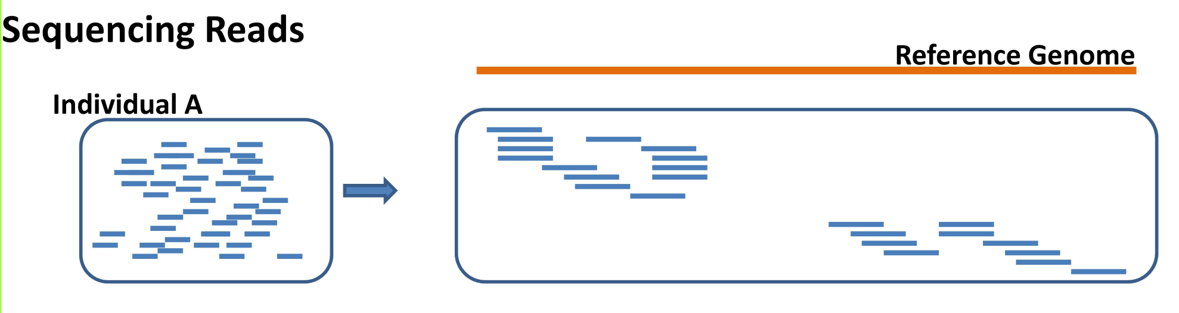
RNA Seq data analysis (1)-Mapping
Main Issues:
Number of allowed mismatche
Number of multihits
Mates expected distance
Considering exon junctions
End up with a list of
# of reads per transcript
These will be our (discrete)
response variable

Slide 21
RNA Seq data analysis (2)-Summarization
Sequencing → genomic locations of many reads
Next task : Summarize & aggregate reads over some biologically meaningful unit, such as exons, transcripts or genes.
Many methods available
Counts # of reads overlapping the exons in a gene,
Include reads along the whole length of the gene and thereby incorporate reads from 'introns'.
Include only reads that map to coding sequence or…

Slide 22
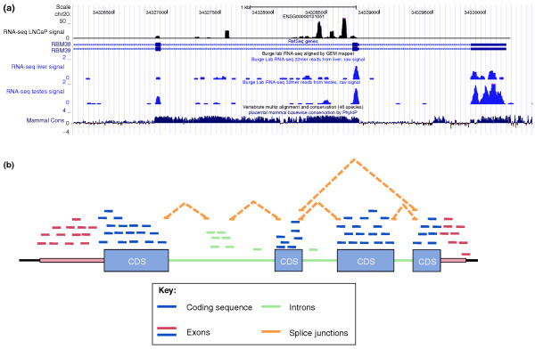
RNA Seq data analysis (2)-Summarization
Notes:
Summarizing mapped reads into a gene level count. (a) Mapped reads from a small region of the RNA-binding protein 39 (RBM39) gene are shown for LNCaP prostate cancer cells [90], human liver and human testis from the UCSC track. The three rows of RNA-seq data (blue and black graphs) are shown as a 'pileup track', where the y-axis at each location measures the number of mapped reads that overlap that location. Also shown are the genomic coordinates, gene model (labeled RBM39; blue boxes indicate exons) and conservation score across vertebrates. It is clear that many reads originate from regions with no known exons. (b) A schematic of a genomic region and reads that might arise from it. Reads are color-coded by the genomic feature from which they originate. Different summarization strategies will result in the inclusion or exclusion of different sets of reads in the table of counts. For example, including only reads coming from known exons will exclude the intronic reads (green) from contributing to the results. Splice junctions are listed as a separate class to emphasize both the potential ambiguity in their assignment (such as which exon should a junction read be assigned to) and the possibility that many of these reads may not be mapped because they are harder to map than continuous reads. CDS, coding sequence.

Slide 23
RNA Seq data analysis (3)-Normalization
Two main sources of bias
Influence of length: Counts are proportional to the transcript length times the mRNA expression level.
Influence of sequencing depth: The higher sequencing depth, the higher counts.
How to deal with this
Normalize (correct) gene counts to minimize biases.
Use statistical models that take into account length and sequencing depth

Slide 24
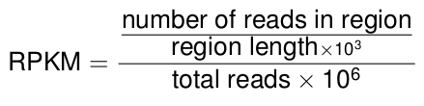
RNA-seq normalization methods
3
RPKM (Mortazavi et al., 2008): Counts are divided by the transcript length (kb) times the total number of millions of mapped reads.
TMM (Robinson and Oshlack, 2010): Trimmed Mean of M values.
EDAseq (Risso et al., 2011): Within-lane gene-level GC-content normalization (corrects for library size, gene length, GC-content)
cqn (Hansen et al., 2011): Conditional quantile normalization (CQN) algorithm combining robust generalized regression (corrects for library size, gene length, GC-content)
Others: Upper-quartile (Bullard et al., 2010); FPKM (Trapnell et al., 2010): Instead of counts, Cufflinks software generates FPKM values (Fragments Per Kilobase of exon per Million fragments mapped) to estimate gene expression, which are analogous to RPKM.

Slide 25
RNA Seq (4)- Differential expression analysis
The goal of a DE analysis is to highlight genes that have changed significantly in abundance across experimental conditions.
In general, this means
taking a table of summarized count data for each library and
performing statistical testing between samples of interest

Slide 26
RNA Seq (4)- Methods for Differential Expression Analysis
Transform count data to use existing approaches for microarray data.
Use Fisher's exact test or similar approaches.
Use statistical models appropriate for count data such as Generalized Linear Models using
Poisson distribution.
Negative binomial distribution.

Slide 27
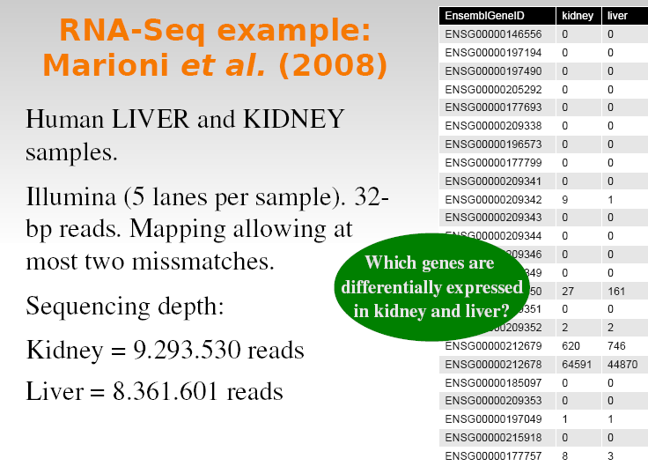

Slide 28
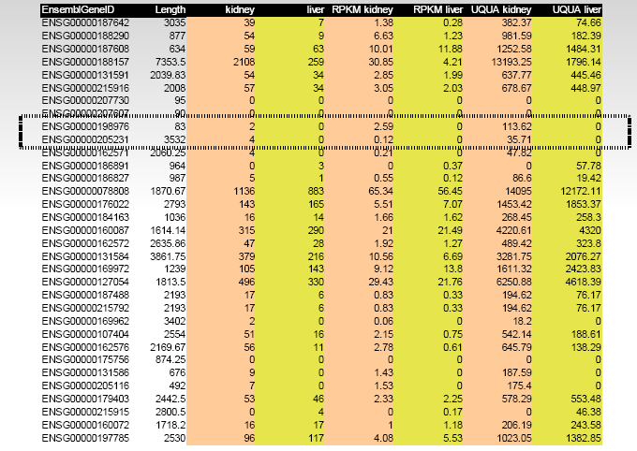
RNA seq example (Normalized values)

Slide 29
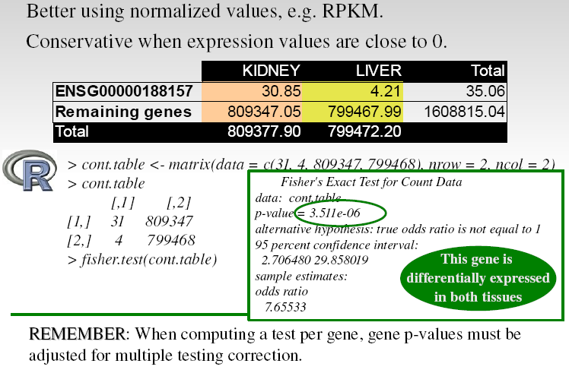
RNA seq example – Analysis (Fisher test)

Slide 30
Statistical models for count data
The number of reads that are mapped into a gene was first modelled using a Poisson distribution
Poisson distribution appears when things are counted
It assumes that mean and variance are the same
However biological variability of RNA-seq count data cannot be captured using the Poisson distribution because data present overdispersion (i.e., variance of counts larger than mean)
Negative Binomial (NB) distribution takes into account overdispersion; hence, it has been used to model RNA-seq data
Poisson distribution has only one parameter λ, while NB is a two-parameter distribution λ and φ.

Slide 31
Analysis methods based on assuming statistical models
Basic analysis methods use the exact test approach:
for each gene (t = 1, ...), and groups A and B, H₀ : λ_{tA} = λ_{tB}
There are better options if data are assumed to follow a Negative Binomial Distribution or some generlization of this.
edgeR allows the option of estimating a different φ parameter for each gene
baySeq uses Poisson-Gamma and BN models estimating parameters by bootstrapping from the data.
DESeq assumes that the mean is a good predictor of the variance.

Slide 32
RNA Seq (5)-Going beyond gene lists (1)
DE analysis yields lists of differentially expressed genes [transcripts, …]
Traditionally these lists arae explored by some type of gene set analysis
RNA-seq has biases (e.g. due to gene length) that require adapting methods developed with microarray
GO-Seq is such a method

Slide 33
RNA Seq (5)-Going beyond gene lists (2)
Results of RNA-seq data can be integrated with other sources of biological data e.g. to establish a more complete picture of gene regulation
RNA-seq has in conjunction with genotyping data identify genetic loci responsible for variation in gene expression between individuals
Integration of expression data & epigenomic information (transcription factor binding, histone modification, methylation) has the potential for greater understanding of regulatory mechanisms.

Slide 34
Additional topics

Slide 35
Additional topics
Transcriptome assembly
Alignment methods and tools
Alternative splicing and isoforms
List of software methods and tools for differential expression analysis of RNA-seq
http://genomebiology.com/2010/11/12/220/table/T1

Slide 36
De novo assembly
Underlying assumptions relative to RNA expression
sequence coverage is similar in reads of the same transcript
strand specific (sense and antisense transcripts)
Assemblers:
Velvet (Genomic and transcriptomic)
Trinity (Transcriptomic)
Cufflinks (Transcriptominc, reassemble pre-aligned transcripts to find alternative splicing based on differential expression)

Slide 37
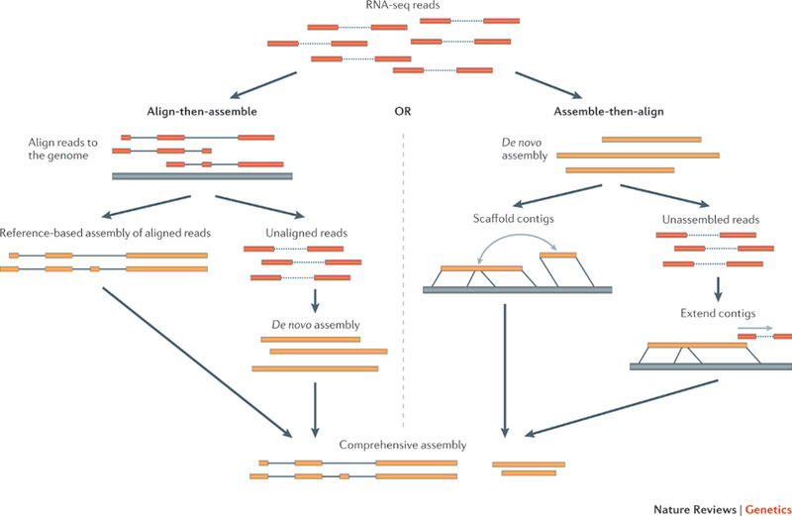
Transcriptome assembly

Slide 38
Alignment methods
Two different approach are possible:
• Align vs the transcriptome
• faster, easier
• Align vs the whole genome
• the complete information

Slide 39
Alignment tools
NGS common alignment program:
BWA
Bowtie (Bowtie2)
• Novoalign
• Take into account splice-junction
• Tophat/Cufflinks

